Slide 1
DESIGN AND IMPLEMENTATION OF A MOBILE-BASED ARCHIVAL AND RETRIEVAL OF MISSING OBJECTS APPLICATION USING IMAGE MATCHING
task 3: requirements analysis
Group one

Slide 2
OUTLINE
INTRODUCTION
REQUIREMENTS ANALYSIS PROCESS:
GATHERING PHASE REVIEW
REQUIREMENTS SPECIFICATION
REQUIREMENT PRIORITIZATION AND CLASSIFICATION
SYSTEM REQUIREMENTS SPECIFICATION
CONCLUSION

Slide 3
I. INTRODUCTION
Requirements analysis overview

Slide 4
II. REQUIREMENTS ANALYSIS
methodology AND RESULTS

Slide 5
Requirements Gathering Review
Identified stakeholders
Elicitation Techniques used

Slide 6
IDENTIFIED STAKEHOLDERS
Random Individuals (end-users )
Development team
Business owner

Slide 7
Elicitation techniques used
Interviews (Individuals and related organizations )
Online surveys
Brainstorming

Slide 8
Requirements Specifications
Functional Requirements
Non-Functional Requirements

Slide 9
Functional Requirements
Image recognition and Realtime processing
User authentication and security
Database Integration
Intuitive user interface design

Slide 10
Functional Requirements
Notification system
Feedback loop
Location based services
Image capture

Slide 11
Functional Requirements
Offline mode
Reward System
Texting and Calling services
Live location between owners and finders

Slide 12
Functional Requirements
Free access to all
Tab to fill Address of finders
Section for reporting missing items
Agency for storing and retrieving

Slide 13
Functional Requirements
Image uploading
Community Section

Slide 14
Non-Functional Requirements
Performance
Scalability
Reliability
Availability

Slide 15
Non-Functional Requirements
Privacy
Security
Compatibility
Usability

Slide 16
Non-Functional Requirements
Maintainability
Regulatory compliance

Slide 17
Requirements Prioritization and classification
Weighted Scoring
MoSCoW classification
Prioritized requirements

Slide 18
Weighted scoring
Impact
Urgency
Feasibility

Slide 19
MoSCoW classification
Must-have
Should-have
Could-have
Won’t-have

Slide 20
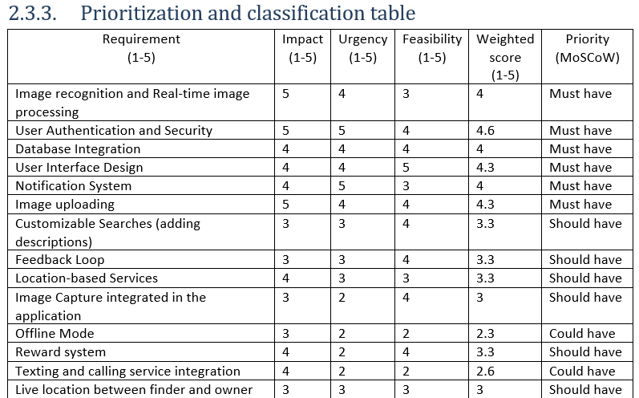

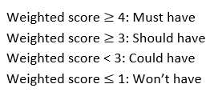
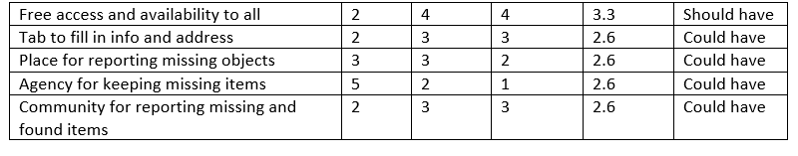

Slide 21
Final Prioritized Requirements
Must-have
Image recognition and Realtime processing
User Authentication and Security
Database Integration
User Interface Design
Notification System
Image Uploading

Slide 22
Final Prioritized Requirements
Should-have
Reward system
Customizable Searches (adding descriptions)
Feedback loops
Location based services
Image capture Integration
Free access to all

Slide 23
Final Prioritized Requirements
Could-have
Offline Mode
Texting and Calling services
Tab for info filling
Agency for reporting and retrieving items
Community Section for reporting lost and found items

Slide 24
System Requirements Specifications
Functional Requirements
Non-Functional Requirements
Interface/Integration Requirements
UI/UX requirements
Data Requirements
Performance Requirements
Security Requirements
Constraints
Assumptions and Dependencies

Slide 25
Interface & Integration Requirements
Interface specification
External Database Integration
Image Recognition service Integration
Data exchange mechanisms
Compatibility Testing
Performance optimization
Documentation and Maintenance

Slide 26
User Interface & User Experience Requirements
User Scenario
User Persona
Scenario Map
User Story Map
User Testing Reports
UX style guide
Site Maps
User Flow Schemes
Wireframes

Slide 27
1) User Persona: Case Study
Name
Background
Characteristics
Motivation
Sarah
35-year-old professional working in a busy corporate environment. She commutes to work daily using public transportation.
Sarah is organized but occasionally forgetful, often misplacing her belongings in the rush of her daily routine. She values efficiency and convenience in the tools she uses.
Sarah's primary motivation is to quickly locate misplaced items, such as her wallet or keys, to avoid disruptions to her daily schedule.

Slide 28
2) User scenario
Sarah opens the application on her smartphone.
She selects the "Report Lost Item" option
Sarah describes the lost item (wallet) and provides any relevant details.
Sarah submits the report and receives a confirmation message.
Sarah describes the lost item (wallet) and provides any relevant details.

Slide 29
3) Scenario Map
User manages their profile and notification settings.
User report lost Item
User searches for a lost item using image matching.

Slide 30
3) User story Map
Sprint 4 Notification system
Sprint 1
Sprint 2
Sprint 3
User registration
Lost item reporting
Item search

Slide 31
Data Requirements
Types of Data
Images of lost items
Metadata
User Authentication Data
User history data
User Feedback Data

Slide 32
Data Requirements
Data Structures and Schema
Centralized database
Relational Schema

Slide 33
Data Requirements
Data Privacy and Security
Compliance
Encryption
Access Control

Slide 34
Data Requirements
Data Retention policies
Retention period
Backup and recovery

Slide 35
Performance Requirements
Response time
Scalability
Resource Utilization
Image processing speed
Notification Delivery time
Database Performance
Usability under load
System Availability
Monitoring

Slide 36
Security Requirements
User Authentication
Data Encryption
Access control
Secure Data storage
Secure communication
Input Validation
Security Update and patching

Slide 37
Constraints
Time Constraints
Technical Constraints
Resource Constraints
Regulatory Constraints
Dependency Constraints
User Constraints

Slide 38
Assumptions and Dependencies
Assumptions
Users have access to smart phones and internet connectivity
Users trust the application to handle their data securely
Users are willing to provide necessary information for finding items (images and descriptions)
Users have basic technological competence to navigate and use the application effectively

Slide 39
Assumptions and Dependencies
Dependencies
Integration with image recognition or third party services and libraries
External Database for image and metadata storage
Compliance with Privacy regulations for handling user Data

Slide 40
Iv . Conclusion

Slide 41
THANK YOU

Slide 42
END
NAME | MATRICULE
MEWOABI NGUEFACK DORE | FE21A239
ALEANU NTIMAEH ENOW | FE21A134
OJONG-ENYANG OYERE | FE21A297
FONGANG KELUAM PAUL DIEUDONNE | FE21A193
TANWIE BRUNO ADEY | FE21A316

